Slide 1

Machine Learning Model Validation Framework
Overview of model validation framework and techniques for machine learning models.

Slide 2

The motivation and the topics
The objective is not to create a new model validation structure but to enhance the existing risk model validation framework with insights on machine learning models. This enhancement will address specific challenges associated with ML and might also consider issues that are shared with conventional modeling approaches.
While the European Union (with GDPR) and the United States have made significant strides in addressing bias and fairness, these concerns haven't been as pronounced in the UAE. Nevertheless, considering the financial and reputational setbacks experienced by prominent tech firms, it's timely to investigate these matters
Data-related challenges are prevalent in banking, including issues of privacy, quality, bias, Drift.

Slide 3




What is model validation and Why do we need it?
Ensure model operates as expected
Evaluate risks
Meet business needs
Manage risks
Model validation identifies potential risks like bias and monitors model performance over time.
Validation guarantees the model aligns with and achieves business objectives.
It puts controls in place to mitigate risks that could impact model performance or lead to issues.
Model validation verifies the model performs according to specifications and requirements.
In summary, model validation is crucial to ensure models operate correctly, evaluate risks, meet business goals, and manage those risks effectively, mandated by cbuae

Slide 4
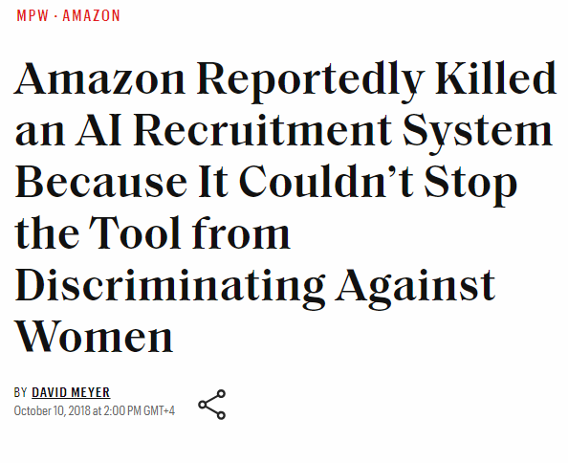
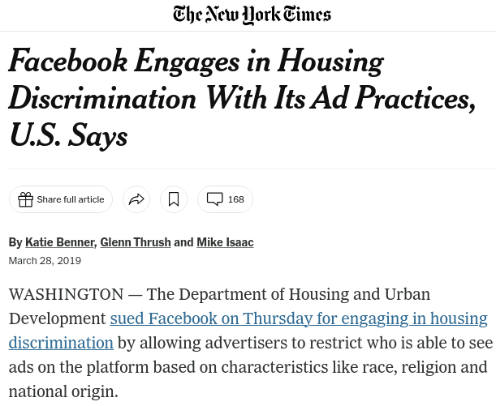
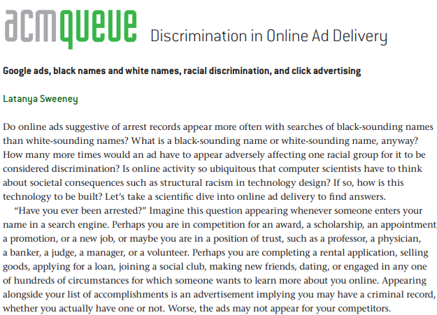
What is model validation and Why do we need it? - II

Slide 5



Why AI/ML
Improves through experience
Data has great value
Widely used including banking
Machine learning models improve performance on specific metrics through experience from data.
Data is like oil for ML models, generating value through training.
ML is used in many sectors like search, phones, agriculture and banking for efficiency.
Machine learning leverages data to improve through experience and is widely used including in banking.

Slide 6



Why ML models need validation
ML models have risks
High risk models
Regulations
Depending on the use case, ML models can have different levels of risk
Models like credit scoring systems face stricter obligations from regulators
Regulators mandate fairness, accountability and transparency(FAT) for high-risk models
ML models, especially high-risk ones, need validation to ensure they meet regulatory and performance requirements including risk mitigating before put to the market

Slide 7
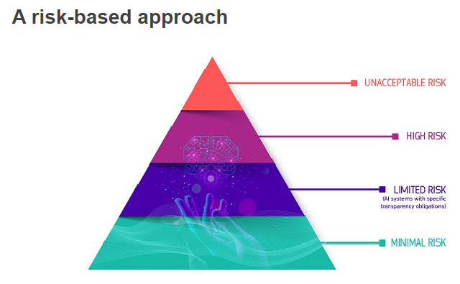
Why ML models need validation
European commission share the risk tier for machine learning product as above figure.

Slide 8
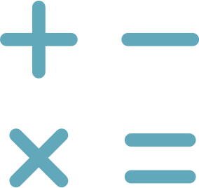

What issues AI/ML present
Data issues
Model issues
Data collection, quality, sampling, transform, lineage, monitor, privacy
Pre-modeling, in-modeling like bias, black box, post-modeling monitor
Proper data and model validation needed throughout the ML pipeline to ensure quality.

Slide 9
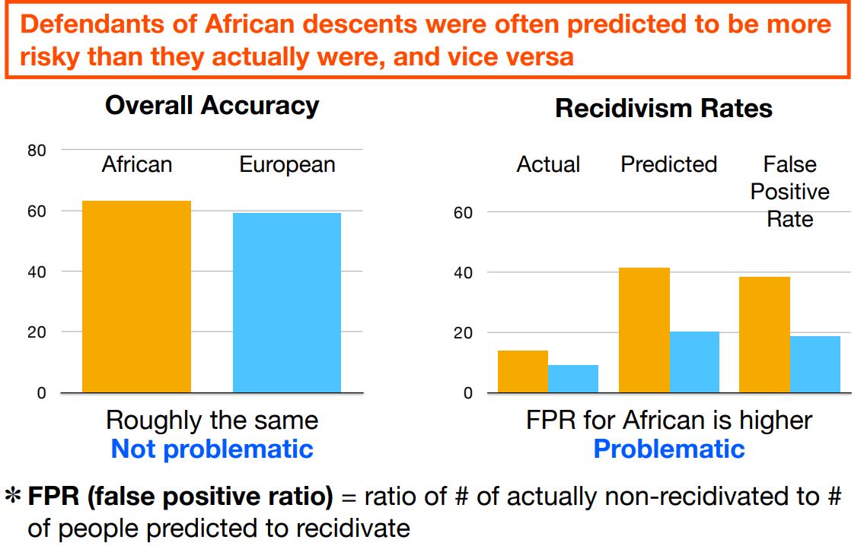
Compas Case Study
The Compas recidivism model, developed by Northpointe, aimed to predict defendants' risk of reoffending. However, investigations found that the model was biased against African-Americans, who were often assigned higher risk scores than white defendants with similar profiles.

Slide 10
Data – I
Data collection bias
Measurement bias, coverage bias, social bias exist in historical data
Data completeness
Evaluate time period, data sources, distribution, labeling definition
Data sampling bias
Data may not represent the population if only approved loans available for the outcome (ri)
Data lineage
Track data transforms to understand how bias propagates
Data drift
Monitor statistical distribution changes over time
Data privacy
Techniques like PII, K-Anonymity, Differential Privacy to protect sensitive data

Slide 11



Data Issues II
Insufficient data
Imbalanced data
Data quality issues
If the data set is inadequate and can't represent the whole data set, then training can lead to poor model performance.
Class imbalances can affect the model's ability to learn patterns for the minor classes.
Missing values, outliers, duplicates and noise in the data can impact model performance.
Careful data collection, sampling, cleaning and balancing is critical for building effective machine learning models.

Slide 12




Model - I
Black box nature
Internal validation
Explainability
Unseen data testing
AI/ML models are often complex black boxes, making it hard to understand how they arrive at decisions
Validate model on design, hyperparameters, loss function, metrics aligned with business objectives
Explain model outputs to ensure they make sense and identify potential biases
Evaluate model performance on new, unseen data to ensure robustness
Evaluating AI/ML from multiple angles is crucial to ensure fairness, accountability and transparency.

Slide 13
Model - II
Methodology alignment
The methodology should align with business needs.
Hyperparameter tuning
Tune hyperparameters to improve model performance.
Optimization function
Choose an appropriate optimization function for training.
Loss function
Select a loss function that matches the business objective.
Performance metrics
Metrics should align with or proxy the business objective.
Model stability
Assess model stability via weight confidence and cross-validation.
Sensitivity analysis
Analyze sensitivity with methods like PDP plots.
Scenario testing
Simulate scenarios and stress test the model.

Slide 14

Model - III
Model explainability is important in areas like finance and healthcare where decisions can have major impacts on people's lives. It allows humans to understand why a model makes certain predictions and helps identify potential biases.

Slide 15
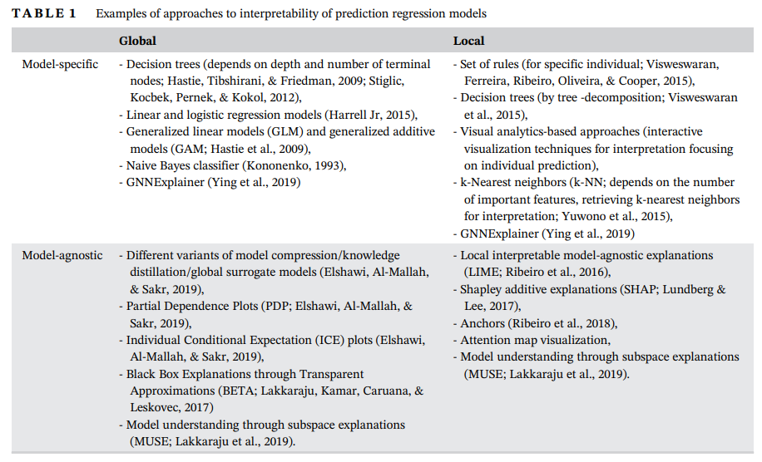
Model – IV

Slide 16
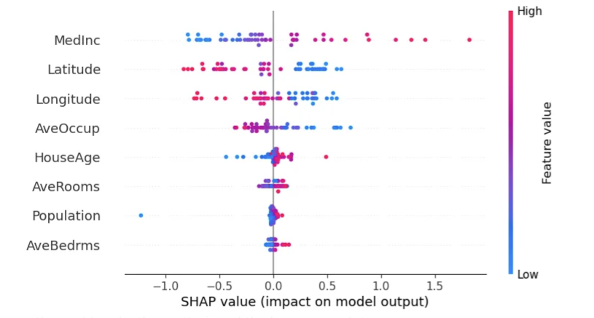
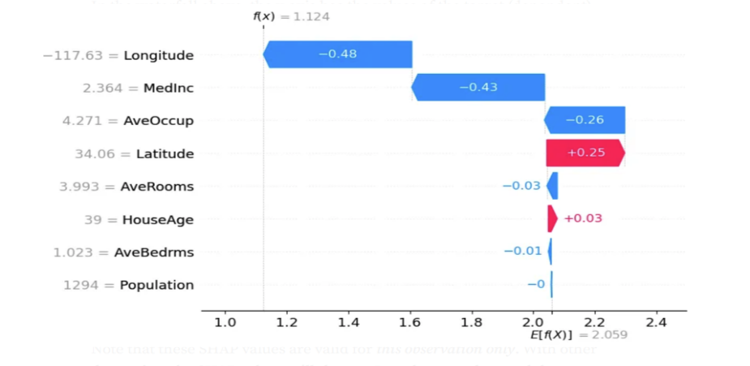
Model – V

Slide 17
Model - VI
Language/Tool Used
Version Control
Micro-service/Container
Python code converted to Kedro pipeline and deployed using GitHub Actions by data science platform team.
GitHub used for distributed version control.
Flask API implemented as service, deployed through Docker containers.
Documentation
Infrastructure
Model Documentation using confluence.
Kedro pipelines and GitHub Actions used for workflow automation.

Slide 18


Model - VII
Decision Monitor (Approval rate, Accept rate etc)
Performance monitor (Default rate)
Data Monitor (Drift detection)
Three lines of defense which is widely used in risk team

Slide 19
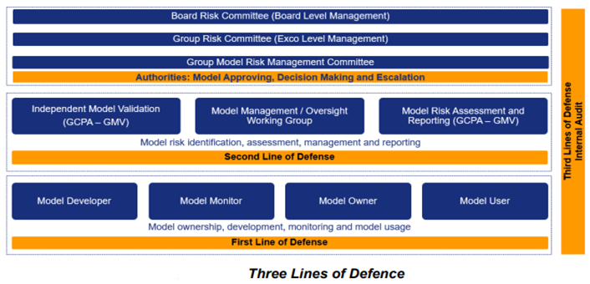
Model – VIII

Slide 20
Model - IX
Data Poison
Membership inference attacks
Model Extraction/Stealing

Slide 21

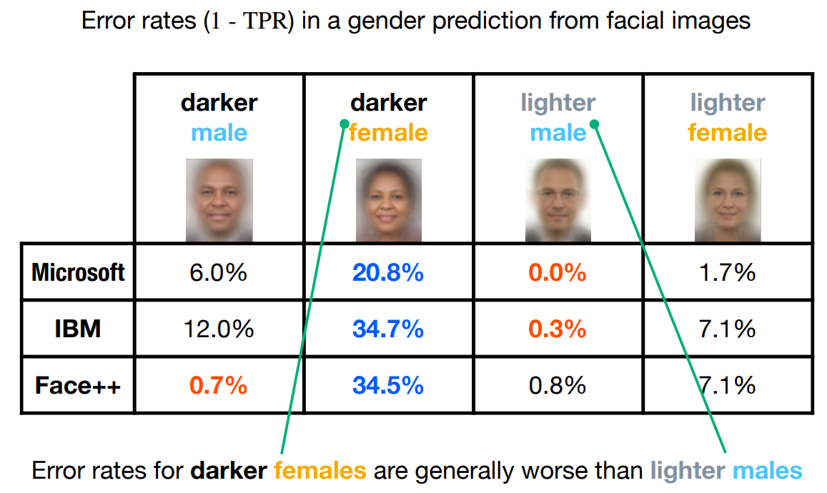
Bias and Fairness
Bias is systematic errors in the data and/or model that leads to potentially unfair outcomes.
Bias existed in the industry; even top technology companies also suffered from the bias problem.
Many bias problems are discussed before, we will brief mention inductive bias.
.

Slide 22


Bias and Fairness – Inductive Bias
Minority loan repayment records ignored
Biased assumptions
ML algorithms may assume minority individuals are less likely to repay loans, ignoring examples of those who have repaid
ML algorithms can make biased assumptions about minority groups that lead to unfair outcomes
Inductive bias occurs when assumptions in ML algorithms cause biased and unfair treatment.

Slide 23
Inductive Bias
Occam's Razor
Prefer simpler models, but may miss exceptions
Smoothness
Prefer smoother decision boundaries and curves
Sparseness
Prefer hypotheses with fewer features
Model Bias
Learned model may not match target model

Slide 24



Fairness Concepts
Equal treatment
Protected attributes
Fairness metrics
All individuals should be treated equally and without bias, regardless of protected attributes
Attributes like race,, religion, national original, gender, marital status, age etc. should not be used to discriminate against people.
Metrics like demographic parity and equality of opportunity help evaluate model fairness across groups.
Ensuring fairness and mitigating bias is crucial for building ethical, trustworthy ML systems.

Slide 25

Fairness Metrics
Demographic parity
Equality of odds
Equality of opportunity
The model predictions should be consistent across various demographic subgroups.
The true positive rate and true negative rate should be equal for different subgroups.
The probability of true positives should be equalized across groupings of a protected category.
Using metrics like these can help measure and improve fairness in machine learning models.
More fairness metric, please refer to the working paper from Amazon Fairness Measures for Machine Learning in Finance

Slide 26



Data Debiasing
Unawareness
Equalize data points
Data augmentation
Remove features correlated with protected attributes
Use sampling to have equal data points (or ratio) for each protected group
Generate more minority data synthetically to balance the dataset
By recalibrating, removing correlated features, equalizing and augmenting data, we can reduce bias caused by imbalanced training data.

Slide 27

Model Debiasing
Change model type
Ensemble modeling
Multi-task learning
Trying different model types like neural networks, random forests etc to see which has lower bias
Using multiple models together and combining predictions to reduce bias
Training model on multiple objectives to learn more generalized representations
By changing the model architecture and training process, we can reduce inherent bias and improve fairness.

Slide 28

Drift
The statistical properties of a dataset change over time. This concept drift can impact the performance and accuracy of machine learning models, which are often trained on historical data. When new data deviates from the training distribution, predictive performance may decline.

Slide 29
Causes of Drift
Seasonal Variations
Changing User Behavior
Data distributions can change due to seasonal factors like holidays, weather, etc.
User preferences and demographics evolve over time, altering data patterns.
Instrumentation Changes
External Events
Modifications to data collection tools and processes introduce variability.
Major events like regulations, economic shifts and
crises impact data.

Slide 30
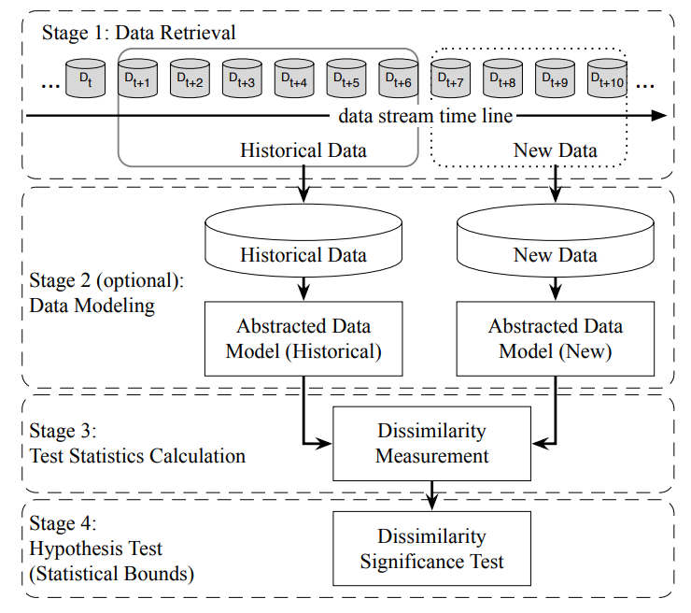
Drift Detection

Slide 31


Drift Detection Methods
Statistical tests
Model-based approach
KS Test and PSI can detect distributional shifts in datasets, other KL divergence family (JS divergence) can also be applied
Train a classification model on reference dataset and monitor performance on test data
Statistical tests and classification models help detect and quantify data drift

Slide 32


Mitigation Strategies
Retrain models frequently
Update model incrementally
Weight recent data higher
Ensemble models on new/old data

Slide 33
Appendix

Slide 34
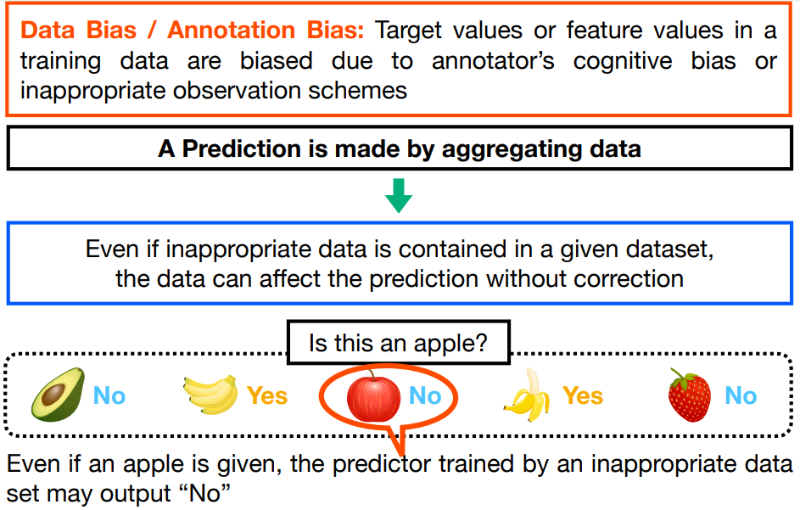
DATA/ANNOTATION BIAS

Slide 35
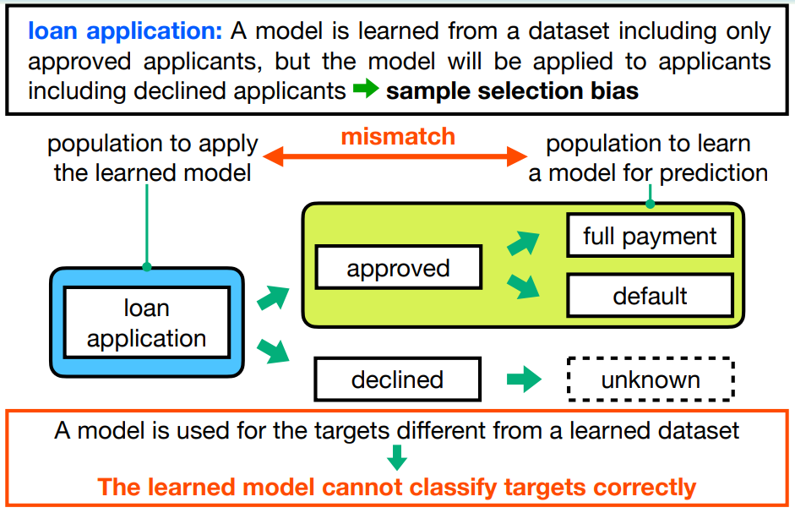
SAMPLE SELECTION BIAS

Slide 36
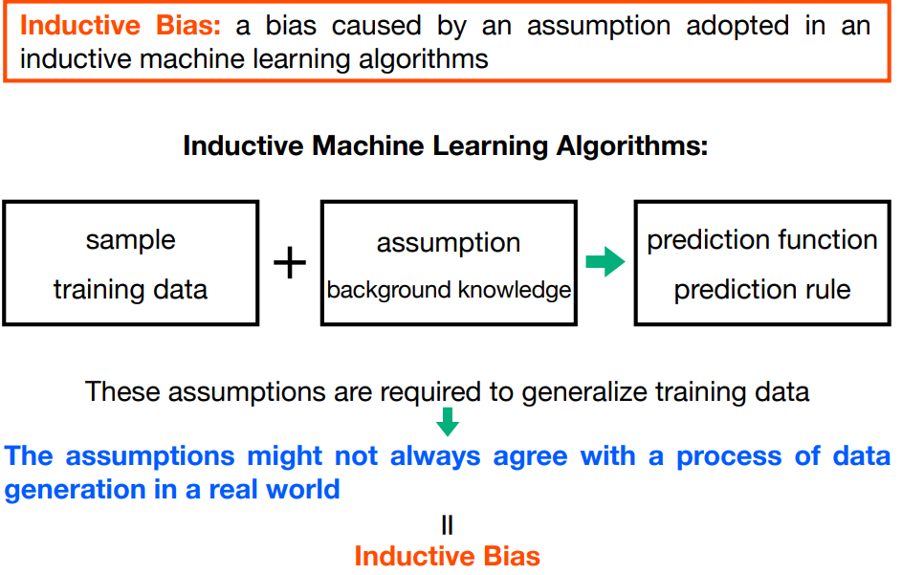
INDUCTIVE BIAS

Slide 37
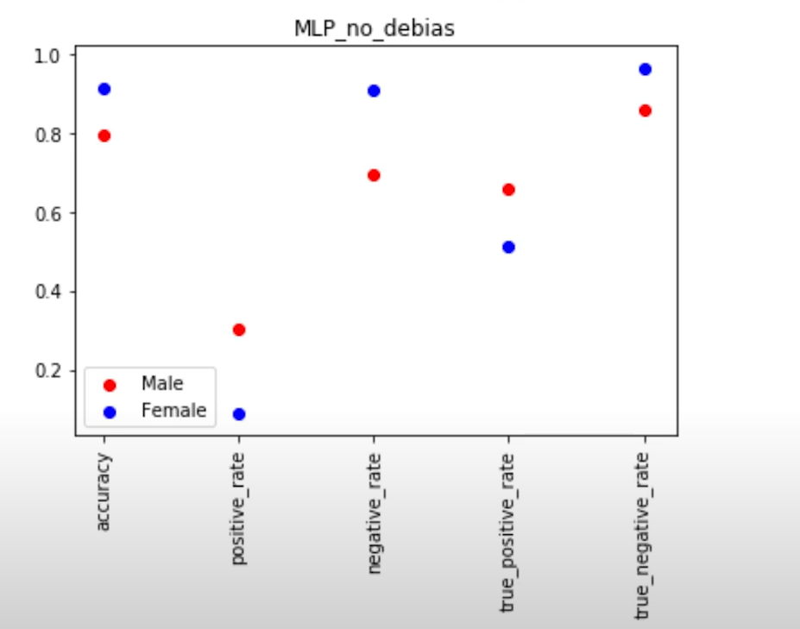
DEBIASED SOLUTION
DATA SOURCES: Adult - UCI Machine Learning Repository

Slide 38
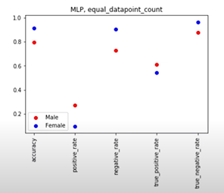
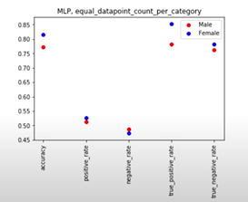
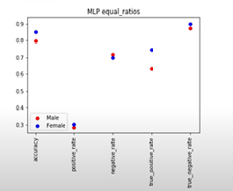
DEBIASED SOLUTION
DATA SOURCES: Adult - UCI Machine Learning Repository

Slide 39
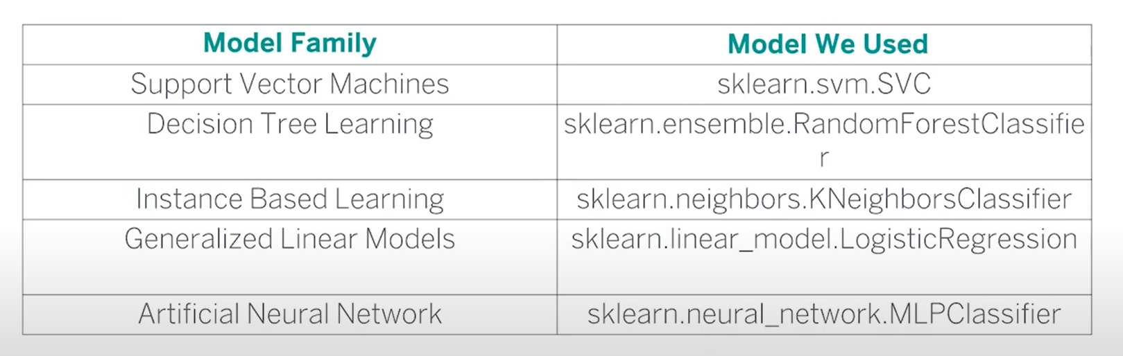
DEBIASED SOLUTION - Model
Different ML models inherently show different levels of bias.
By changing the model type and architecture, we can observe which one tend to be inherently less biased
Multi-model architecture
1. Hard Voting: Final prediction is the majority prediction among all model
2. Soft Voting: Final prediction is the average prediction

Slide 40
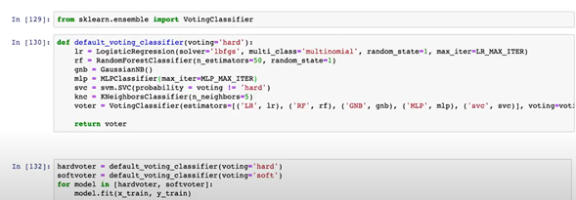
DEBIASED SOLUTION - Model
Multi-model architecture

Slide 41
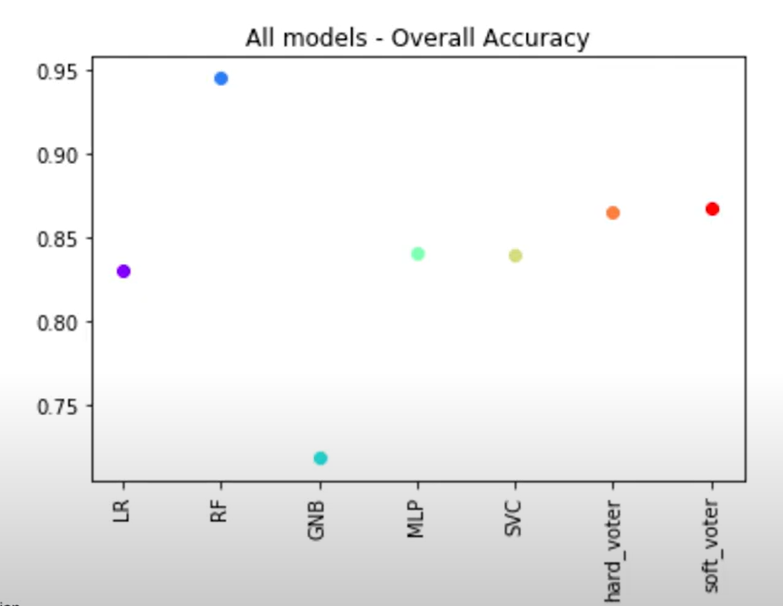
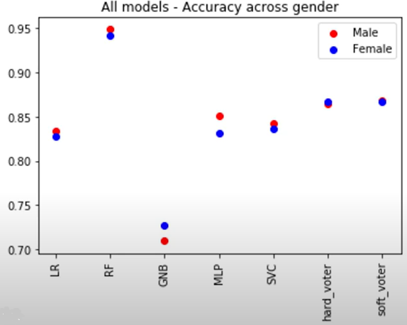
DEBIASED SOLUTION - Model

Slide 42
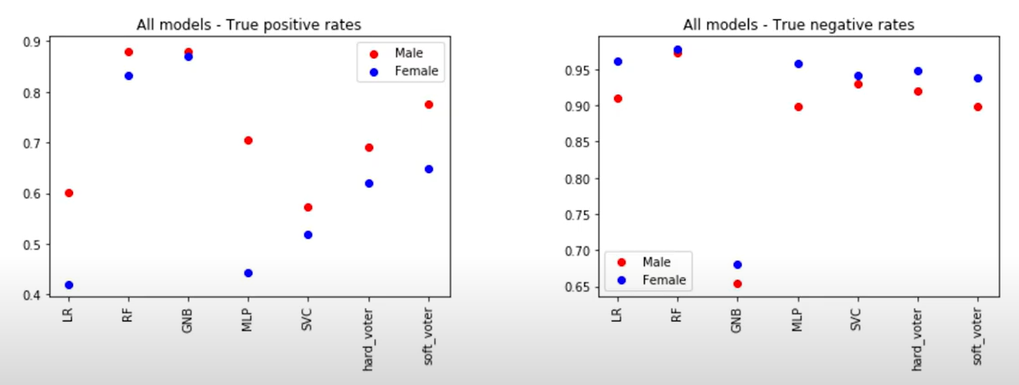
DEBIASED SOLUTION - Model

